Slide 1
WELCOME
LangGo – Name of the class

Slide 2
Classroom rules
1.Be on time
2.Be interactive
3.100% or Nothing
4.Do all Daily Challenges

Slide 3
Review
Các cụm từ học được từ DC:
Take a look
Take a bus
Take an exam
Go for a walk
Take a chance
Take a photo
Take an underground
Take a break
Wash clothes
Take an umbrella
Write an email
Have a look
Clean the house
Have a shower
-
-
-
-
-
-
-
It takes me 20 mins to wash clothes
It takes + sb + time + to V
It takes her 5 mins to /go to school on foot/ walk to school
Once a week, rarely/seldom/hardly = hiếm khi
At + time (am, pm)
12 am: night
12 pm: noon
She/he goes

Slide 4

Lesson 4:
Consonants 2

Slide 5
OBJECTIVES
Review 14 consonants
10 consonants
Review IPA

Slide 6
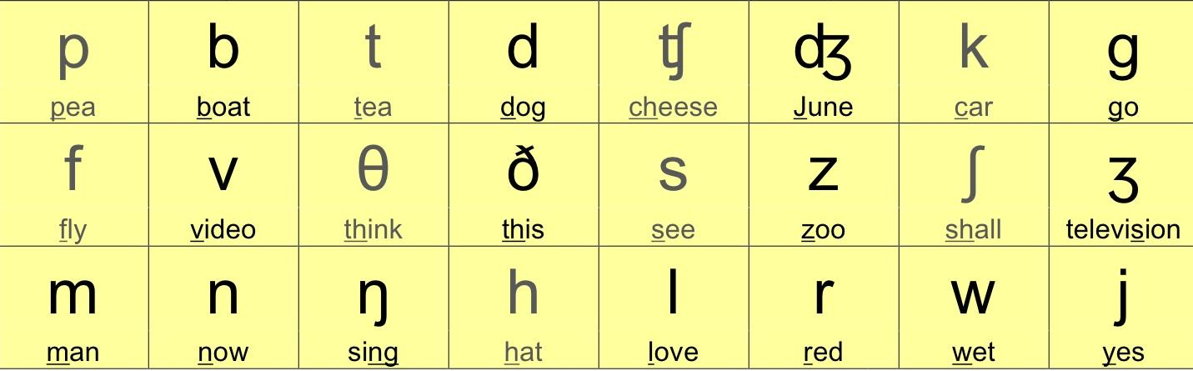
CONSONANTS

Slide 7

Sound /θ/ and /ð/

Slide 8
Sound /θ/
th
thank /θæŋk/ thought /θɔːt/ | author /ˈɔːθə/ anything /ˈeniθɪŋ/ something /ˈsʌmθɪŋ/ | math /mæθ/ fourth /fɔːθ/

Slide 9

Sound /θ/
Thank you Thought Thousand Thirsty Thursday | Thirty–three Author Anything Something Birthday | Athlete Math Fourth Worth Month
Notes:
3 groups write down and compete

Slide 10


I think I thought a thought,
but the thought I thought
is not the thought
that I thought I thought.

Slide 11
Sound /ð/
th
the /ðə/ weather /ˈweðə/ | mother /ˈmʌðə/ clothes /kləʊðz/ this /ðɪs/ | breathe /briːð/ other /ˈʌðə/

Slide 12
Exercise: Read these sentences.
The author talks about the fourth book.
/ði ˈɔːθə tɔːks əˈbaʊt ðə fɔːθ bʊk/
2. There is something under the thick tree.
/ðeər ɪz ˈsʌmθɪŋ ˈʌndə ðə θɪk triː/
3. My brother buys a lot of clothes.
/maɪ ˈbrʌðə baɪz ə lɒt ɒv kləʊðz/
4. They take a deep breath, and then breathe out slowly.
/ðeɪ teɪk ə diːp breθ, ænd ðen briːð aʊt ˈsləʊli/
5. Heather wants to go to Thailand next month.
/ˈheðə wɒnts tuː ɡəʊ tuː ˈtaɪlænd nekst mʌnθ/
Notes:
Student’s book Ex.A p23

Slide 13


Slide 14
Unvoiced vs Voiced
/s/
/z/
/f/
/v/
/ʃ/
/ʒ/
/tʃ/
/dʒ/
/t/
/d/
/p/
/b/
/k/
/g/
/θ/
/ð/

Slide 15

Sounds
/h/ - /j/

Slide 16
Sound /h/
h
hair /heə/ hill /hɪl/ how /haʊ/ help /help/ | he /hiː/ has /hæz/ house /haʊs/ hear /hɪə/ | behind /bɪˈhaɪnd/ hurry /ˈhʌri/ home /həʊm/ how /haʊ/

Slide 17
Sound /j/
y | u | i
yard /jɑːd/ yours /jɔːz/ yes /jes/ yellow /ˈjeləʊ/ | use /juːz/ university /ˌjuːnɪˈvɜːsəti/ unit /ˈjuːnɪt/ computer /kəmˈpjuːtə/ | onion /ˈʌnjən/ opinion /əˈpɪn.jən/ view /vjuː/ million /ˈmɪl.jən/
Notes:
Khẩu hình /i:/, hạ lưỡi và hàm xuống

Slide 18
Exercise: Read these sentences
My mom used to make onion soup at home.
/maɪ mɒm juːzd tuː meɪk ˈʌnjən suːp æt həʊm/
We have to hurry home.
/wiː hæv tuː ˈhʌri həʊm/
My house is behind the hill.
/maɪ haʊs ɪz bɪˈhaɪnd ðə hɪl/
I practiced yoga yesterday.
/aɪ ˈpræktɪst ˈjəʊɡə ˈjestədeɪ/
Are you the youngest person in your family?
/ɑː juː ðə ˈjʌŋɪst ˈpɜːsᵊn ɪn jɔː ˈfæmɪli/
Notes:
Student’s book Ex.D p24

Slide 19
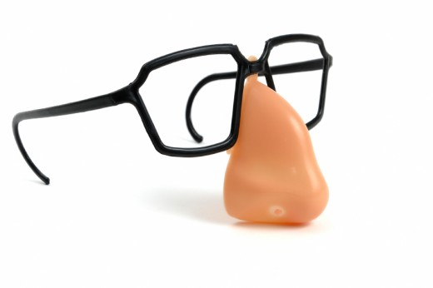
Sounds
/m/-/n/-/ŋ/

Slide 20
Sound /m/
m
am /æm/ supermarket /ˈsuːpərˌmɑːrkɪt/ map /mæp/ mother /ˈmʌðər/ | moon /muːn/ ham /hæm/ more /mɔːr/ me /miː/

Slide 21
Sound /n/
n
banana /bəˈnɑːnə/ notebook /ˈnəʊtˌbʊk/ engineer /ˌenʤɪˈnɪər/ night /naɪt/ | shine /ʃaɪn/ none /nʌn/ sun /sʌn/ new /njuː/

Slide 22
Sound /ŋ/
ng
going /ˈɡəʊɪŋ/ bring /brɪŋ/ singer /ˈsɪŋər/ evening /ˈiːvnɪŋ/ | long /lɒŋ/ thing /θɪŋ/ strong /strɒŋ/ king /kɪŋ/
Notes:
Cuống lưỡi chạm vào phía sau vòm họng

Slide 23

Sounds
/l/ - /r/ - /w/

Slide 24
Sound /l/
l | ll
bloom /bluːm/ law /lɔː/ love /lʌv/ life /laɪf/ live /lɪv/ | beautifully /ˈbjuːtɪfᵊli/ ball /bɔːl/ wall /wɔːl/ all /ɔːl/ well /wel/
Notes:
Đầu lưỡi chạm chân răng cửa hàm trên, dùng giọng/cuối từ thì cong lưỡi lên

Slide 25
Sound /r/
r | wr
red /red/ rose /rəʊz/ rice /raɪs/ right /raɪt/ | write /raɪt/ wrist /rɪst/ wrap /ræp/ wrong /rɒŋ/
Notes:
Miệng tròn, đầu lưỡi nâng hơi uốn vào trong, hạ lưỡi

Slide 26
Sound /w/
w | wh
wool /wʊl/ sweater /ˈswetər/ winter /ˈwɪntər/ woman /ˈwʊmən/ | what /wɒt/ where /weər/ when /wen/ why /waɪ/
Notes:
Môi giống /u:/, nâng cuống lưỡi, đầu lưỡi thấp

Slide 27
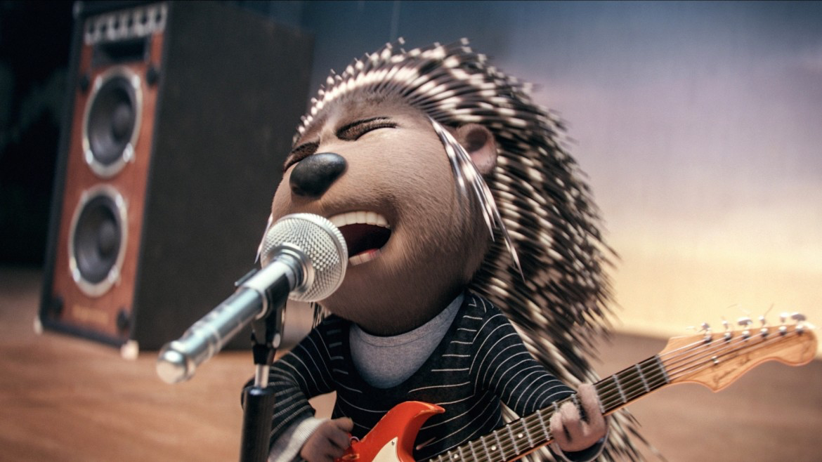
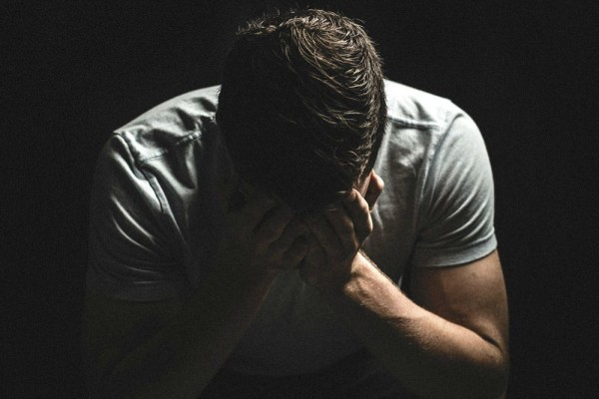
sing
sin
/sɪŋ/
/sɪn/

Slide 28
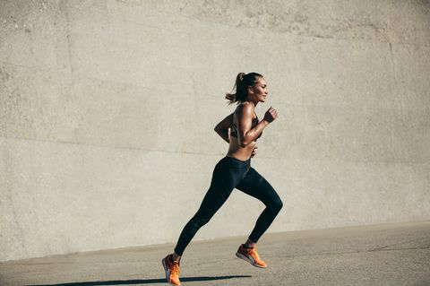

run
rum
/rʌn/
/rʌm/

Slide 29

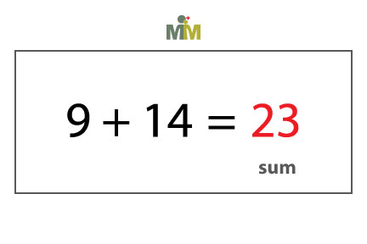
sun
sum
/sʌn/
/sʌm/

Slide 30
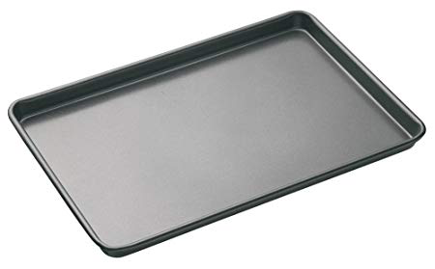
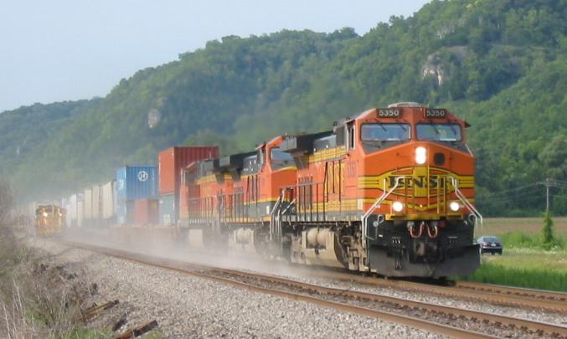
tray
train
/treɪ/
/treɪn/

Slide 31


nice
nine
/naɪs/
/naɪn/

Slide 32


fine
five
/faɪn/
/faɪv/

Slide 33
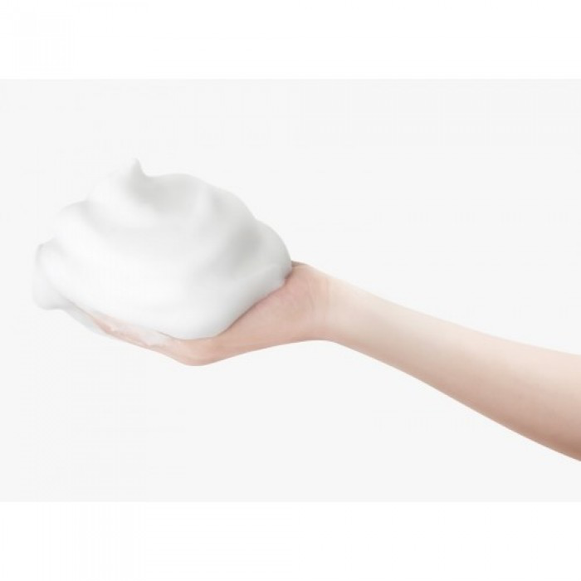
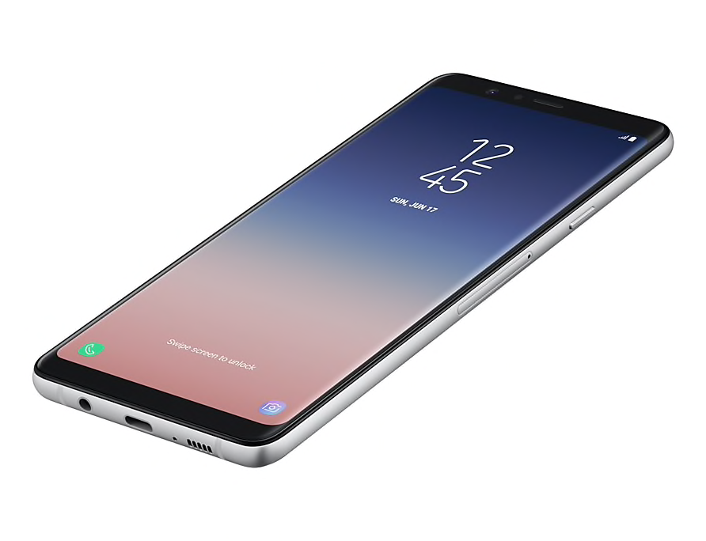
phone
foam
/fəʊn/
/fəʊm/

Slide 34
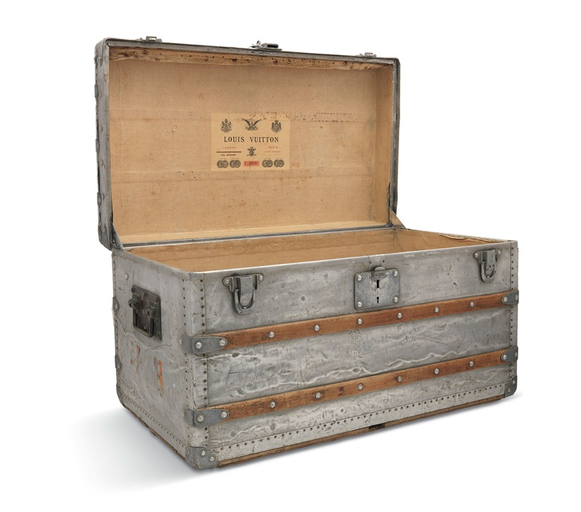
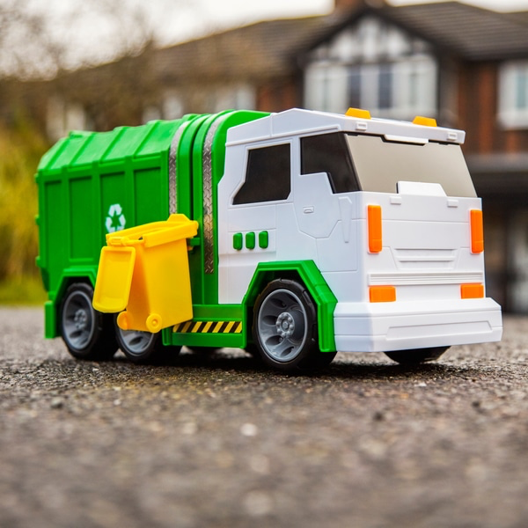
trunk
truck
/trʌŋk/
/trʌk/

Slide 35


lime
line
/laɪm/
/laɪn/

Slide 36

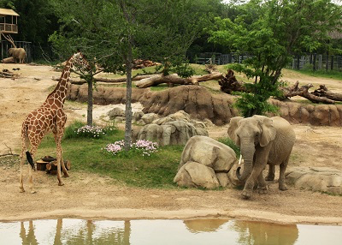
you
zoo
/juː/
/zuː/

Slide 37

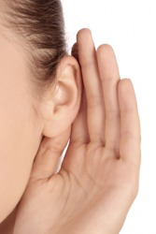
year
hear
/jɪə/
/hɪə/

Slide 38
Exercise: Read these sentences.
1. His mom makes lunch for him every Monday.
/hɪz mɒm meɪks lʌnʧ fɔː hɪm ˈevri ˈmʌndeɪ/
2. She danced with my friend near the campfire.
/ʃiː dɑːnst wɪð maɪ frend nɪə ðə ˈkæmpˌfaɪə/
3. Do you remember your grandmother’s phone number?
/duː juː rɪˈmembə jɔː ˈɡrænˌmʌðəz fəʊn ˈnʌmbə/
4. Can you bring the missing ingredient?
/kæn juː brɪŋ ðə ˈmɪsɪŋ ɪnˈɡriːdiənt/
5. I like to drink something hot in the evening.
/aɪ laɪk tuː drɪŋk ˈsʌmθɪŋ hɒt ɪn ði ˈiːvnɪŋ/
Notes:
Student’s book Ex.F p26

Slide 39
Thanks!

